Slide 1
An Introduction to the R Programming Language
Lesson 2
Reproducible Reporting

Slide 2
Lesson Goals
Practice working with the different components of a R Markdown file
Lesson Objectives
Understand why reproducible reporting is important
Create an R Markdown document and generate different types of output files
Practice modifying each component of a R Markdown file

Slide 3
Typical Data Science Pipeline
From R for Data Science (https://r4ds.had.co.nz/introduction.html)
Notes:
We refer to R for Data Science, a free text available online frequently
Provide a nice model for the typical process of analyzing data to communicate
Focus for this hour is the machinery that allows us to capture this whole process in a way that is reproducible and also can communicate to others

Slide 4
Your Turn #1
Break into groups of 3-4
List 3 benefits of doing data analysis using spreadsheet software like Microsoft Excel
List 3 drawbacks/problems with doing data analysis using spreadsheet software like Microsoft Excel

Slide 5
Why is reproducibility important?

Slide 6
Case
37 y/o M informatician with PMH of email overload disorder
Request from informatics staff:
“Please provide detailed data from your 2 year old analysis of total departmental effort spent performing test cancellations for a SBAR calling out the need to invest effort in duplicate checking rules for the ongoing EHR implementation project”
Analysis is in an Excel file but original raw data is nowhere to be found
Consider the above scenario, but with someone else performing the original analysis
Would it be less work to start from scratch and rewrite the analysis?
Notes:
Programming couse but we probably have a fair number of clinicians
Let’s talk about a case

Slide 7
Replication vs Reproduction
Replication: other people collect new data
Scientific gold standard
Difficult and time-consuming
Reproduction: other people analyze the same data
Does not by itself validate the analysis …
Has been proposed as a minimal standard
Notes:
Focus of learning the skills we’re teaching today isn’t strictly research
But we should define 2 terms frequently discussed in the research world: Replication and Reproduction.
Replication: other people collect new data and reach the same conclusions
This is the scientific gold standard but is also difficult and time-consuming.
Reproduction: other people analyze the same data and reach the same conclusions
Reproduction does *not* show by itself that the study is valid. There could still be problems with external validity of the conclusions, however, since it’s theoretically so much easier than going out there and doing an entirely new study, reproducibility has been proposed as a minimal standard to examine the scientific validity of the conclusions of a study.
And as the data analysis part of a study becomes more complex, reproducibility of the data analysis becomes more important.

Slide 8
The Duke Cancer Scandal
Chemo sensitivity from microarrays
Errors first, then misconduct
Clinical trials based on flawed models
Papers retracted, lawsuits settled
Notes:
The Duke cancer scandal, perpetrated by Anil Potti and Joseph Nevins, is a case study that has been extensively covered in scientific and lay press.
Potti and Nevins tried to use microarray gene expression data of tumor tissue to predict sensitivity to chemotherapeutic agents. That was a highly anticipated technology back in the mid-2000s, and their papers got published in high-profile journals including Nature Medicine, JAMA, and the NEJM.
Unfortunately, there were serious errors in the analysis pipeline and then the investigators tried to cover that up
Even more unfortunately, clinical trials were based on flawed models, and patients were allocated to the wrong treatment arms
In the end, 11 papers were retracted, and Duke settled 11+ lawsuits.
Although media coverage focused on misconduct, the root cause of patient harm here was that errors that were made during the analysis stage weren’t appreciated in time before clinical trials started. And the main reason these errors remained undetected for such a long time is that there wasn’t a record of the data analysis steps that would have allowed others to examine what the investigators had done.

Slide 9
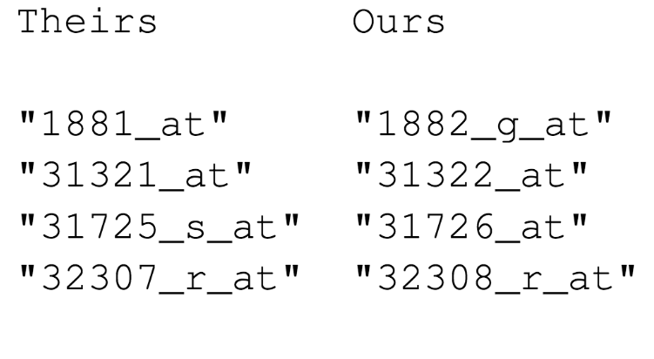

“Common errors are simple, Simple errors are common”
https://youtu.be/tN31vZj0LZY
Notes:
Keith Baggerly, a bioinformatician at MD Anderson, is kind of the hero of this saga. I’ll give you an abbreviated version of it here, but I encourage you to follow the link on this slide to hear the full story.
Baggerly was asked by clinical collaborators to try to reproduce the results from one of the early papers, be he consistently got different results.
After trying to resolve these inconsistencies with the authors of the paper, he embarked on an epic effort in Forensic Bioinformatics (in Baggerly's words: “what must they have done with the raw data to get the result that they reported in the paper - no matter what the method section says”)… and documented the errors he found. Here is an example:
These are a few of the hundreds of probe sets – each corresponds to a gene – that the Duke investigators reported to predict sensitivity to 5-FU.
Left (“Theirs”): probe sets as they were reported in the paper.
Right (“Ours”): the probe sets which Keith Baggerly got when he re-did the clustering analysis to get to the list of significantly associated probe sets.
You might appreciate that there is an off-by-one indexing error (frameshift) – root cause: the program the Duke investigators used has a GUI that requires two inputs, first: a list of gene expression values, WITH header row; and second: a list probe sets, in the same order as the first list, but WITHOUT a header row. So when you use Excel and you cut and paste and include the header row this is what you get.
This is just one of many errors Baggerly and his colleague Kevin Coombes discovered. All of the errors were simple, like label reversal, batch effects, and indexing errors. These errors are common and don’t necessarily indicate that the investigators who make them are incompetent. Peer review of a well-documented analysis actually makes these kinds of errors easy to find and fix. But without documentation, it’s very time consuming.

Slide 10
Point-and-Click Is Not Reproducible
Interactive tools do not record user actions
Manual documentation is error-prone
Manual analyses cannot be repeated on new data sets or shared with collaborators
Computer code can precisely document each step of the analysis
Notes:
A critical barrier to reproducibility is the widespread use of graphical user interface “point-and-click” type software.
These interactive tools don’t record user actions.
Even if you try to manually document every action you take in MS Excel, it’s usually not complete enough for other others to retrace your steps without having to make a lot of assumptions.
Another important drawback of manual data analysis is its inefficiency. If you want to analyze a new or even slightly different set of data (and most of the time you do a complex analysis, you will!) you’ll have to start over and do everything again.

Slide 11
Why YOU Should Do Data Analysis Reproducibly
“Can we redo the analysis with this month’s data?”
“Why do the data in Table 1 not seem to agree with Figure 2?”
“Why did I decide to omit these six samples?”
Your closest collaborator is You from 6 months ago
(But you don’t answer e-mails)
Notes:
Here’s what I think are some of the most important reasons to make sure my work is reproducible.
…
* …
On a more serious note - if you’re analyzing clinical data and might reasonably change patient management based on your findings, that makes it so much more important that you take steps to assure your analysis is free of errors.

Slide 12
Using R for Reproducibility
Programming in R (or another language) allows one to reproduce analysis steps exactly or perform same analysis on new data
Better practice is to create documentation about analysis to accompany and explain code
Best practice is include documentation and code in one place

Slide 13
Using R Markdown to Support Reproducibility
Notes:
R Markdown is a tool that facilitates programming in R and integrating documentation in the same place you are programming

Slide 14
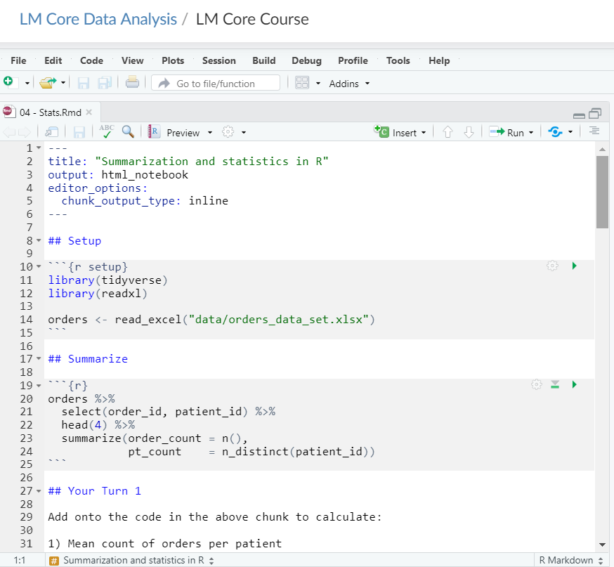
Header
Code chunk
Text

Slide 15
Header
Starts and ends with 3 dashes
Title in quotes
Output format
Notes:
You’ve created your first markdown document!
Let’s jump back to the file and take a closer look at the components
When you open a new document Rstudio auto-generated a header section that has the metadata you provided
This controls the output – if you decide to change the title, for example, you can modify here and the output document will be changed

Slide 16
Text
Include hyperlinks with [text](link) format
1 asterisk for italics (*italics*)
1 asterisk for italics (*italics*)
2 asterisks for bold (**bold**)
Hyphens (-bullet 1) for bullet points
Notes:
Another component of the file is the text
These are the white background areas and are intended to hold your non-programming text to explain an analysis, for example
Distinct from a document editor like Microsoft Word in that there is no point and click formatting
But it can parse Markdown, a lightweight markup language that is pretty easy to learn
Here are a few nuggets on formatting on this slide

Slide 17
https://www.rstudio.com/wp-content/uploads/2015/02/rmarkdown-cheatsheet.pdf
Notes:
There is an R Markdown cheat sheet that includes most of the Markdown syntax in one place

Slide 18
Code chunks
Language
Chunk name
Open/close with 3 backticks
Run chunk
Code in body of chunk
Notes:
So where does the code go?
We place these in “chunks” that are executable independently and have a very unique syntax
Backticks (top left of your keyboard) open and close code chunks

Slide 19
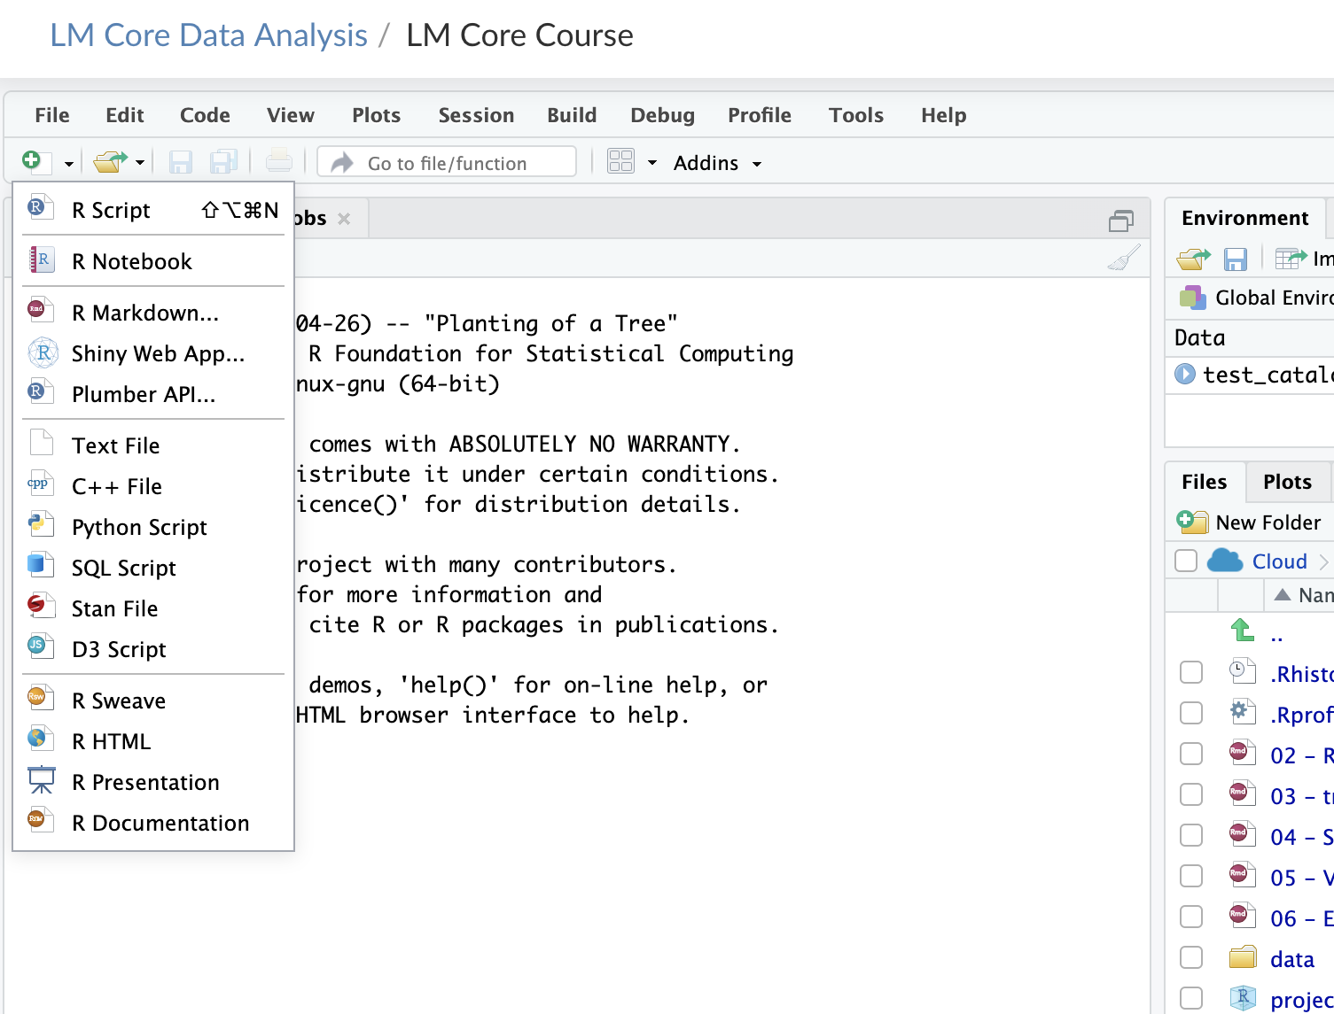

Slide 20
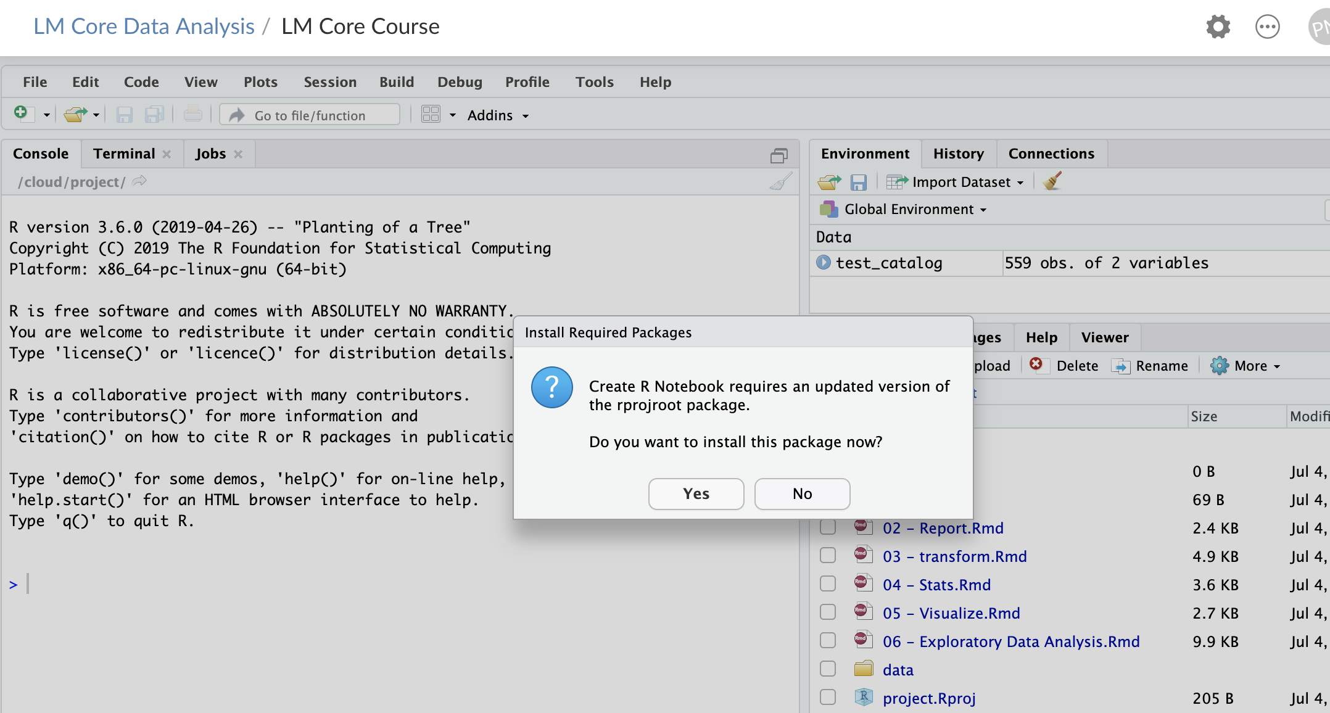

Slide 21
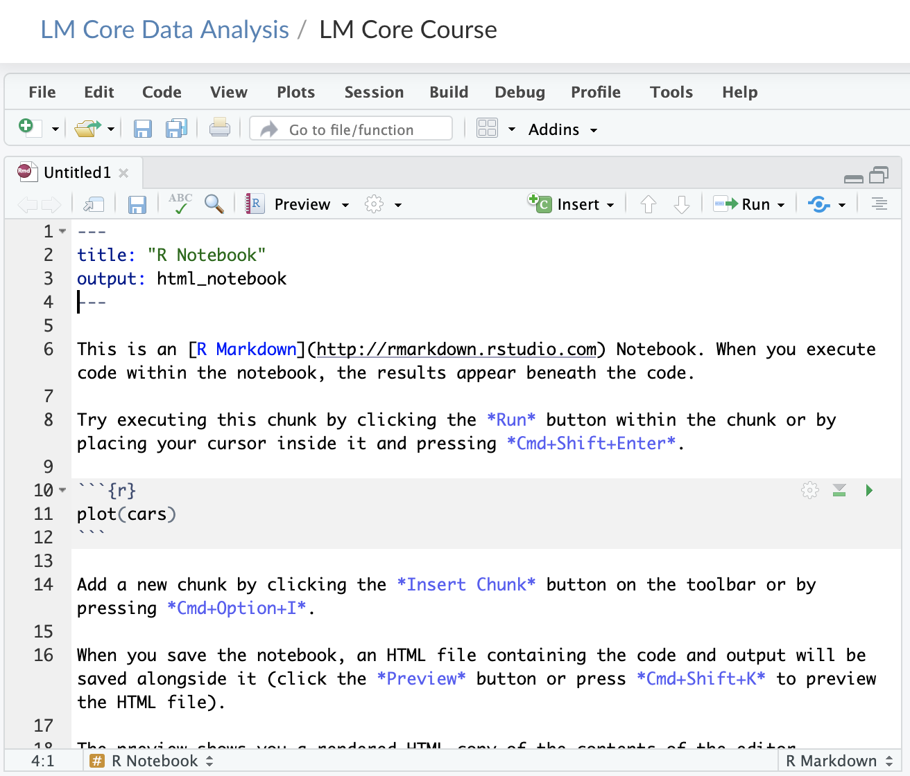

Slide 22
Your Turn #2
Change the title of your R Notebook to “My First R Notebook” by modifying the header.
Add your name as the author by adding another line to the header:
Author: “Your Name”
Add a second level heading (##) at the end of the notebook called “My Calculation”
Notes:
Let’s practice a little markdown
In practice what I’ve asked you to do is redundant since you can include this info in the header but it is good practice

Slide 23
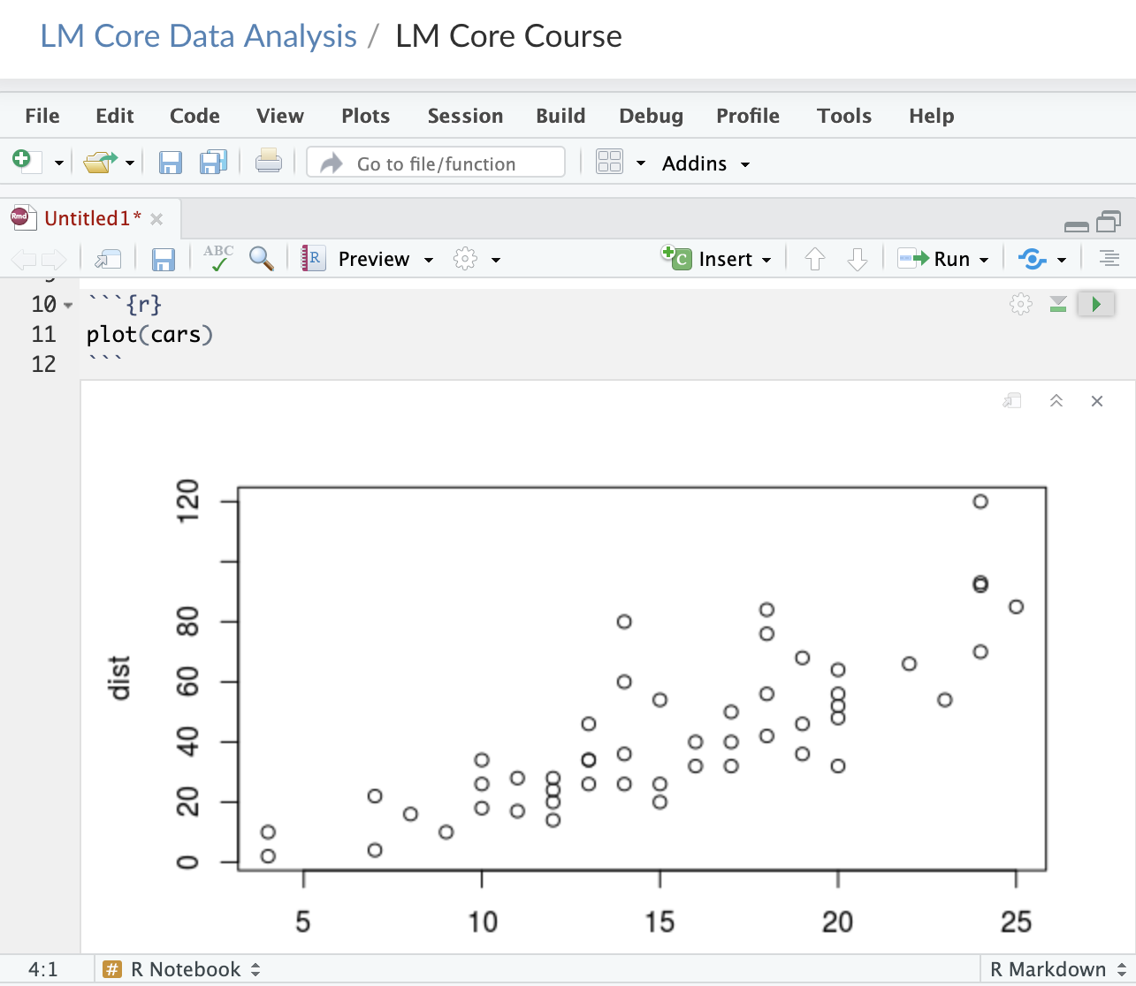
Run code chunk

Slide 24
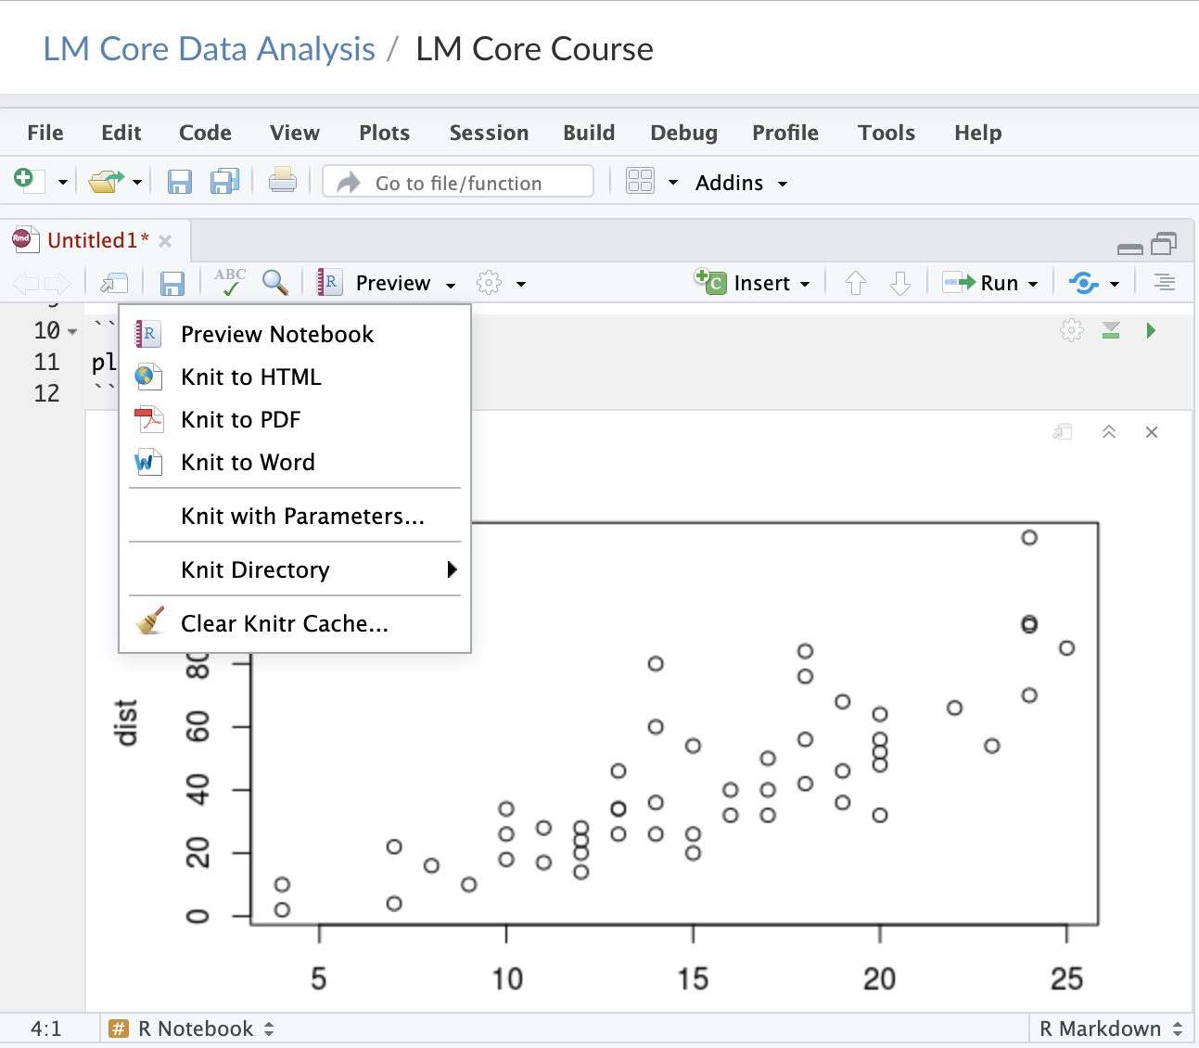

Slide 25
Your Turn #3
1. Under your new heading insert a code chunk into white space using Insert button on top right of code window
2. Add the following to your new code chunk:
mean(c(10, 20, 30))
3. Execute code chunk by pressing Run button on top right of code chunk
Notes:
Annoying to type 3 backticks every time you want to insert a chunk so let’s walk through doing this with the Rstudio editor

Slide 26
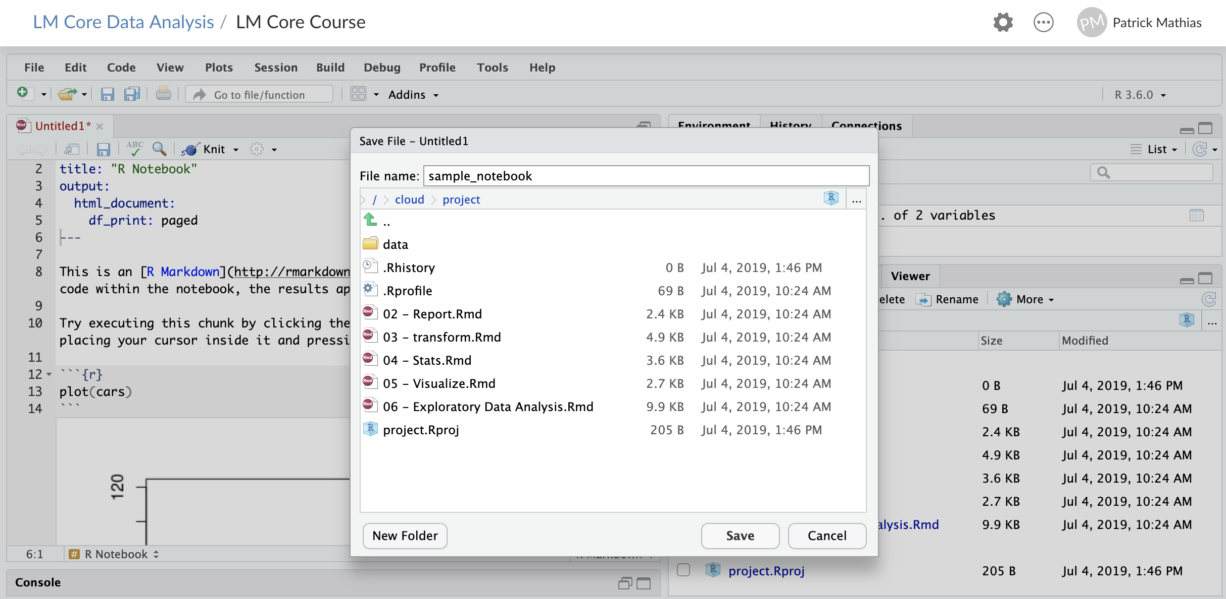

Slide 27
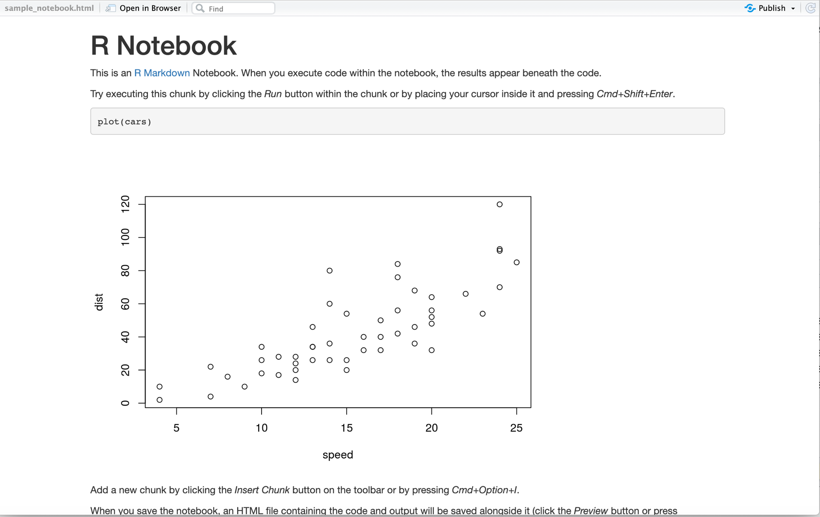

Slide 28
What Else?
Notes:
Now that you’ve learned to create some basic plots that can be embedded into your R Markdown document we’ll wrap up experimenting with other document types

Slide 29
Why name Code Chunks?
Jump between chunks
Notes:
Can name code chunks but you don’t have to
Why might you want to?

Slide 30
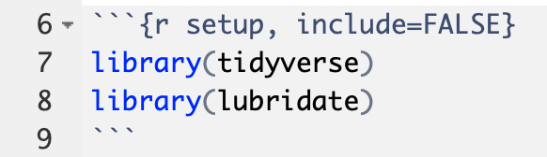
“Setup” Chunk & Chunk Options
chunk name (optional)
“chunk option”
don’t show code in rendered document
for dealing with dates
Notes:
“setup” this is a label for a this code chunk, completely optional
Include = FALSE. This is a chunk option that tells R what to do with this particular chunk to render it. If you check the back of the R Markdown ref guide, you’ll see that if you set the chunk option include = FALSE R will run the code chunk but not include its code in the final document. The setup chunk is usually hidden, well, because it’s ugly.
Again, please run each code chunk as we go. Otherwise you will get errors further down below since the lower down code depends on higher up code.

Slide 31
Chunk options

Slide 32
Keyboard Shortcuts
Insert a code chunk into white space within your open R Markdown document using:
Windows: CTRL+ALT+i
Mac: COMMAND+OPTION+I
Execute using shortcuts:
Windows: CTRL+SHIFT+ENTER
Mac: COMMMAND+SHIFT+ENTER

Slide 33
Multiple Output Formats are Available
Pandoc universal document converter can create multiple document types:
html
pdf
docx
Can also create presentations and dashboards
Including Powerpoint (most recent version of RStudio)

Slide 34
Your Turn #4
Create a pdf of your R Notebook using “Knit to pdf”
Note: if non-executable code is present in code chunks, R will not be able to process it
Notes:
Let’s try this out

Slide 35
Lesson Goals
Practice working with the different components of a R Markdown file
Lesson Objectives
Understand why reproducible reporting is important
Create an R Markdown document and generate different types of output files
Practice modifying each component of a R Markdown file

